Slide 1
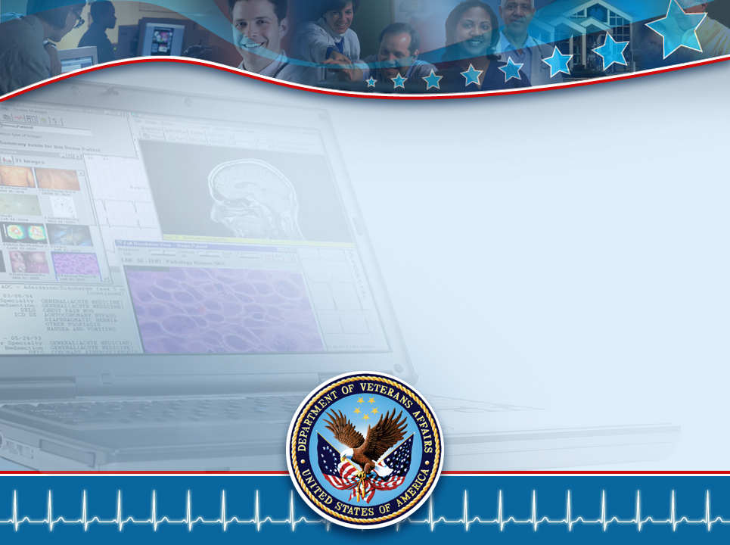
Information Modeling
Service-Oriented Architecture
Galen Mulrooney
(contractor to VHA)
Galen.Mulrooney@va.gov
June 3, 2009
V 1.1

Slide 2
Service Oriented Architecture Definitions
“Service Oriented Architecture (SOA) is a paradigm for organizing and utilizing distributed capabilities that may be under the control of different ownership domains”
OASIS Reference Model for Service Oriented Architecture 1.0 - (emphasis mine)
“Set of services that a business wants to expose to its customers and partners or other portions of the organization”
Source: IBM – (emphasis mine)

Slide 3
Information Modeling in SOA
In order for a SOA to work, it is critical that service providers have a common understanding of the structure and meaning of the data being exchanged
Therefore, a “model” of some kind is needed
  What form should this model take?
Is it possible to have a single, agreed upon model?
  What about different technological requirements?
  What about different viewpoints?

Slide 4
Information Architecture
Information Architecture is the analysis and design of the data used in information systems
  Modeling semantics and reference knowledge common to a wide range of artifacts
  Leveraging the semantics to ensure consistency across models/artifacts
  Using the same semantics as a basis for logical and physical database model generation, software component and service generation, rule development (e.g., in production rule-based systems), etc.
It’s all about logical consistency, validation, and reuse
It’s also about ensuring interoperability within an enterprise and between that enterprise and its trading partners

Slide 5
Information Architecture (cont.)
The art and science of understanding the objectives of information in the context of the intended audience
Information Architecture relates the Business Architecture to Information Technology
  It's the high level description of business information and communication
  Enables the translation of business perspectives to/from IT
Business Strategy and Information Architecture are closely related
  Information Architecture enables the existing Business Strategy
  Information Architecture fosters new Business Strategies

Slide 6
Information Architecture in Health Care
Legal Electronic Medical Record
  Definition and additional data about “metadata” elements that are deemed to be officially part of the Legal Electronic Medical Record
Message “payload” design
  Definition of the contents of data sent to/from software systems as they fulfill business workflows
Database and warehouse design
Data standardization and data quality efforts
Data requirements for quality improvement programs
Medical research
Clinical decision support

Slide 7
A Health Care SOA Scenario
Note that these services might be “home-grown” or commercial products
Pharm.
Service
Lab
Service
Nursing
Service
Clinical Services
getLabResult("
<Patient ID=123/>
<LabObservation testCode=276148/> ")
Service Communication Layer (aka ESB, “backbone”, “spine”, etc.)
HL7 v3, NCPDP, X12, CDA, etc.
External
Trading
Partners
EHR
Service
Demo-
graphics
Service
Termin-
ology
Service
External
Comm.
Service
CDS
“common” Services
EHR
<MicrobiologyObservation> ...
<Organism code=567891/> <- staph.
<AntibioticSensitivityObservation
antibiotic=454798 <- tetracycline
value='>=48'
units=78654 <- col. form. units
interpretation=731974/> <- resistant
CDA=Clinical Document Architecture
EHR=Electronic Health Record
ESB=Enterprise Service Bus
HL7=Health Level Seven
NCPDP=Natl. Council of Prescription Drug Programs
X12=Accredited Standards Committee X12

Slide 8
Model Transformations
How can one static data model meet all the implementation needs (database, domain model, payload structure)?
Answer: Model transformations
  Computational Independent Model (CIM)
    Conceptual model, aka Domain Analysis Model
  Platform Specific Model (PSM)
    Adds concepts needed by a type of platform, e.g., keys
  Platform “Model”
    Language used by platform, e.g., DDL, WSDL, CORBA
Model Driven Architecture (MDA) and Unified Modeling Language (UML) provide tools for automating model transformations

Slide 9
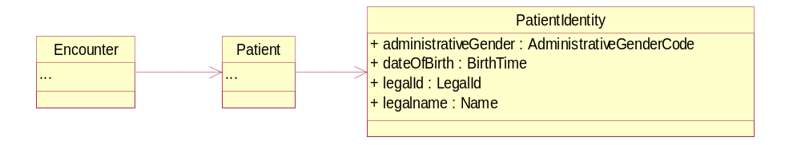
UML Transformed to Other Languages
Class Diagram
XML Schema Definition
Java
<xs:element name="PatientIdentity" type="VaIdentity" substitutionGroup="personIdentity" />
- <xs:complexType name="PatientIdentity">
- <xs:complexContent>
- <xs:extension base="PersonIdentity">
- <xs:sequence>
- <xs:element name="administrativeGender" type="AdministrativeGenderCode">
- <xs:annotation>
<xs:documentation>A value representing the gender (sex) of a person. The allowable values for this field as specified by the DS DAT for Demographics are: F (Female), M (Male) and UN (unspecified).</xs:documentation>
</xs:annotation>
...
public interface PatientIdentity extends personSRDTs.PersonIdentity
{
livingSubject.AdministrativeGenderCode getAdministrativeGender();
void setAdministrativeGender(livingSubject.AdministrativeGenderCode administrativeGender);
livingSubject.AdministrativeGenderCode addNewAdministrativeGender();
livingSubject.BirthTime getDateOfBirth();
void setDateOfBirth(livingSubject.BirthTime dateOfBirth);
livingSubject.BirthTime addNewDateOfBirth();
...

Slide 10
MDA Transforms to Other Models
Conceptual Model (CIM)
Model to Model Transformations
Payload PSM
Database PSM
Java Object PSM
Model to Implementation Transformations
Database
Java Application
Payload

Slide 11
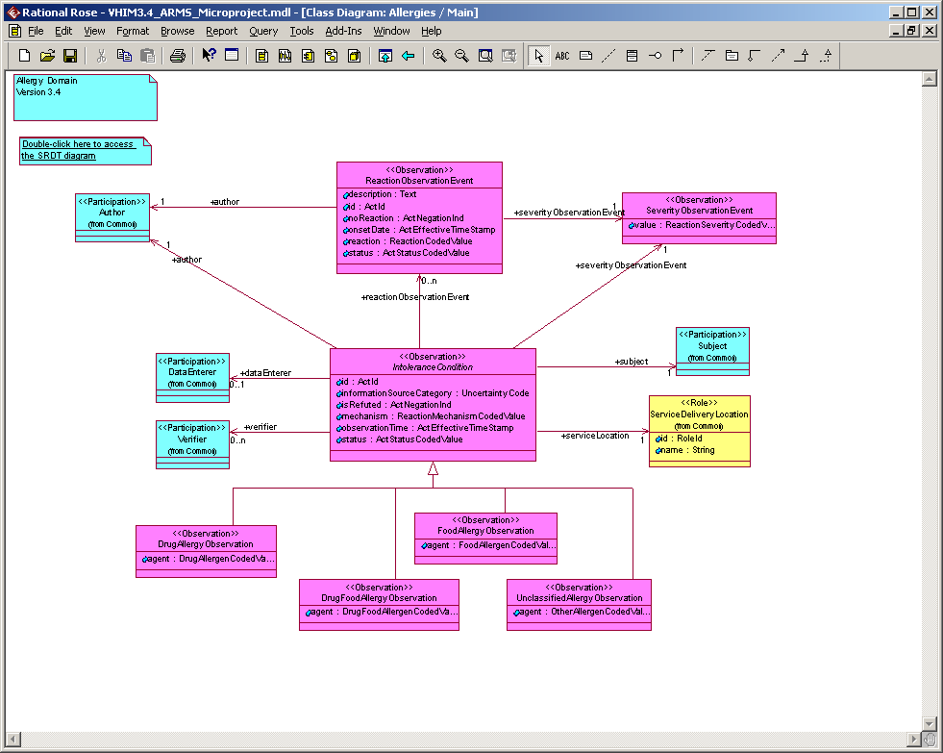
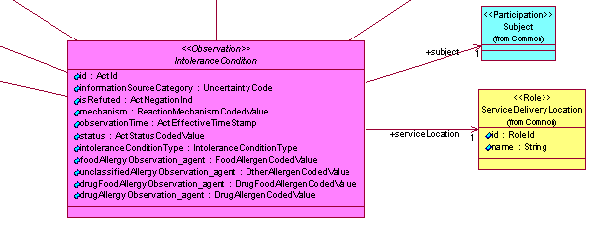
CIM to PSM Example
Note the transformation from one model that has four subclasses to distinguish the type of the allergy, to another model that has a single class which uses an allergy type to distinguish the type of allergy

Slide 12
Transformations and Standards
The HL7 Reference Information Model (RIM) is used as a UML Profile, allowing a rigorous transformation to/from HL7 version 3 artifacts
  One can import and export HL7 Model Interchange Format (MIF) files to/from the UML model
This can also be used to model other Standards
  NCPDP SCRIPT* being reverse-engineered
  Efforts underway at ASC X12 as well
CDA authoring tooling is now being built
* NCPDP SCRIPT is a messaging standard used to convey pharmacy insurance claim information

Slide 13
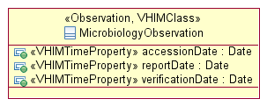
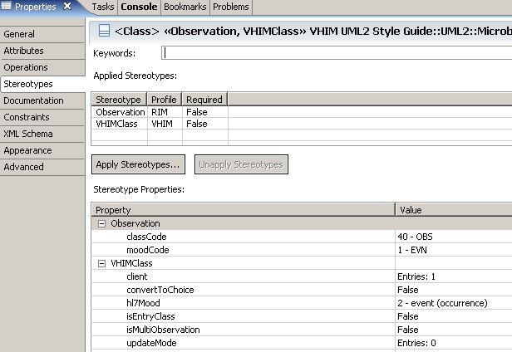
Align Classes with HL7 v3
The Class Code and Mood Code are explicitly identified in the model; allowing for computable transformations to/from HL7 v3 message structures

Slide 14
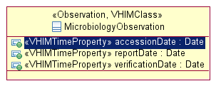
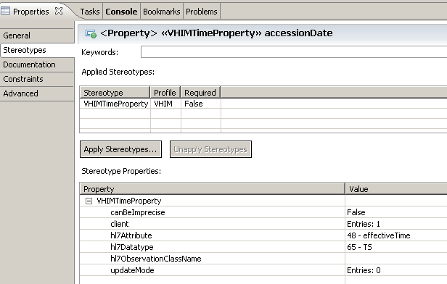
Align Attributes with HL7 v3 (cont.)
The HL7 RIM Attribute and constrained datatype are identified in stereotype properties, not in the model itself

Slide 15
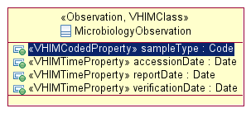
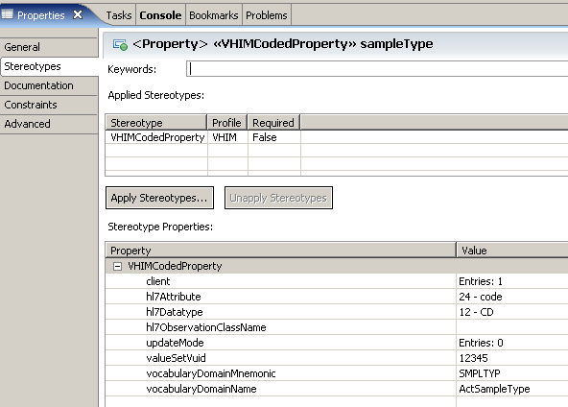
Mechanism to Align with Terminology
The model explicitly links to both the VHA Unique concept Identifier (VUID) and to the HL7 value set

Slide 16
UML Style Benefits
The UML Style provides
  More computationally independent models; HL7-isms and XML-isms not in the diagrams
    Easier for Subject Matter Experts to understand and validate
  Ability to automate Quality Assurance checks based on the semantics of the model, not just structure
    This is done through Eclipse extensions using the Eclipse Modeling Framework (EMF) Validation Framework

Slide 17
Lessons Learned
There will be a time between the As-Is and the To-Be where you have a mixture of both
  Need to simultaneously maintain transforms to/from the UML model and HL7 v2 Electronic Data Interchange format, HL7 v3 XML, and CDA XML
  “As-Is” systems do not understand the “To-Be” concepts and constructs – these need to be removed from As-Is artifacts
One challenge was the mapping to/from HL7 v2 data types and HL7 v3
  Certain v2 data types are needed for “backward compatibility”

Slide 18
Lessons Learned (cont.)
Transformations require extensive testing
  Some HL7 messages might not conform to specifications
  Validation of mappings is manually intensive and time consuming
Data migration/transformation will bring to light data quality issues
  Some data may be need to be cleansed
  Adjustments may be needed to the UML model or the transformations
Some issues require the involvement of the authoritative source to make changes
  Important to have business input
  Need a “Data Stewardship” program to ensure authoritative business “owners” for semantics, governance, and error resolution/data quality

Slide 19
Future Work
Research is being conducted to explore the linkage between UML and RDF, OWL, and SBVR*
  See the Object Management Group’s (OMG) Ontology Definition Metamodel (ODM)
Exploration of the use of ontologies and semantic web technologies
Can the structural and ontological modeling worlds be bridged?
*
RDF=Resource Description Framework, a family of World Wide Web Consortium (W3C) specifications. See www.w3.org
OWL=Web Ontology Language, a family of knowledge representation languages for authoring ontologies. See www.w3.org
SBVR=Semantics of Business Vocabulary and Business Rules, an OMG standard. See www.omg.org

Slide 20
Summary
To design a SOA, you need
  Dynamic (Behavioral) Models
  Static (Information) Models
  Terminology Models
UML can be used effectively for the first two
  Enables the benefits of Model Driven Architecture
  Link to terminology in UML Profile
    Further exploration of the linkages between Information and Terminology modeling is needed
Model Transformations allow a single model to satisfy multiple purposes

